Slide 1
Databricks
MAKEATHON FHNW 2021
Notes:
Recommendation engine which predicts a person's rating for a specific product
Improve the experience of the customer, providing a list of articles the user might be interested in purchasing in a small area of the webpage
Recommendation engines are very common among customers within online retail
The idea is to build a recommendation engine using machine learning at scale
The size of the dataset does make the complexity of the algorithm a key aspect of the challenge

Slide 2
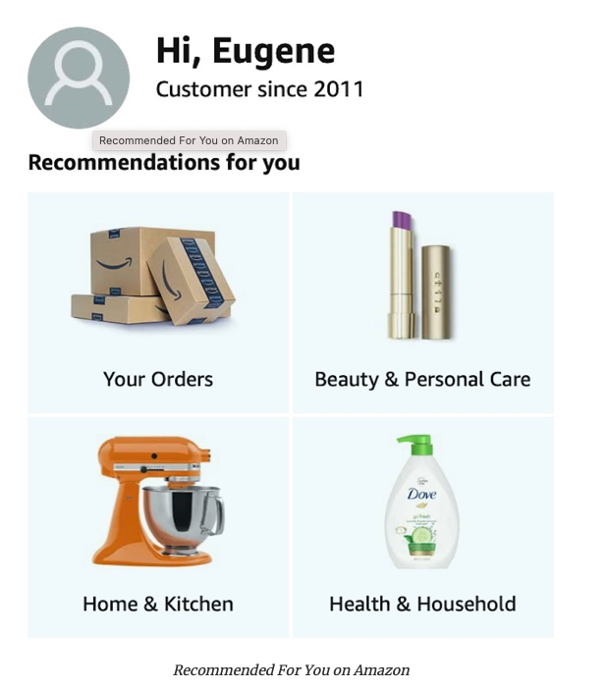
Goal: Real-Time Personalised Product Recommendation
Notes:
Recommendation engine which predicts a person's rating for a specific product
Improve the experience of the customer, providing a list of articles the user might be interested in purchasing in a small area of the webpage
Recommendation engines are very common among customers within online retail
The idea is to build a recommendation engine using machine learning at scale
The size of the dataset does make the complexity of the algorithm a key aspect of the challenge

Slide 3



Big Data Problem
How to scale?
15 Million
Products
43 Million
Customers
= 6.45 E+14 distinct cells

Slide 4


Machine Learning: Collaborative Filtering
Basic Idea: Find similar behaviour from users
Find
Also bought
Users that bought coffee machines

Slide 5
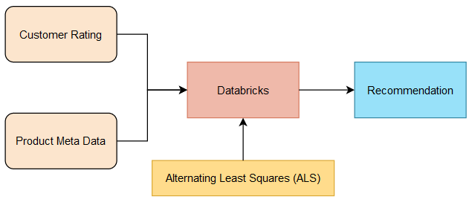
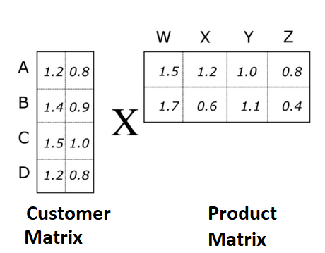
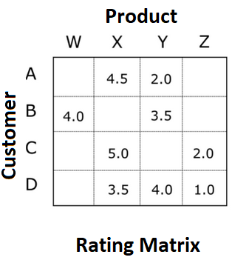
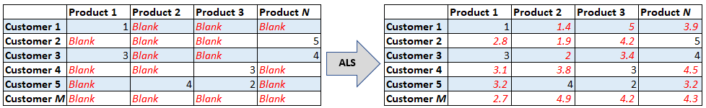

Machine Learning: Math
https://towardsdatascience.com/prototyping-a-recommender-system-step-by-step-part-2-alternating-least-square-als-matrix-4a76c58714a1

Slide 6
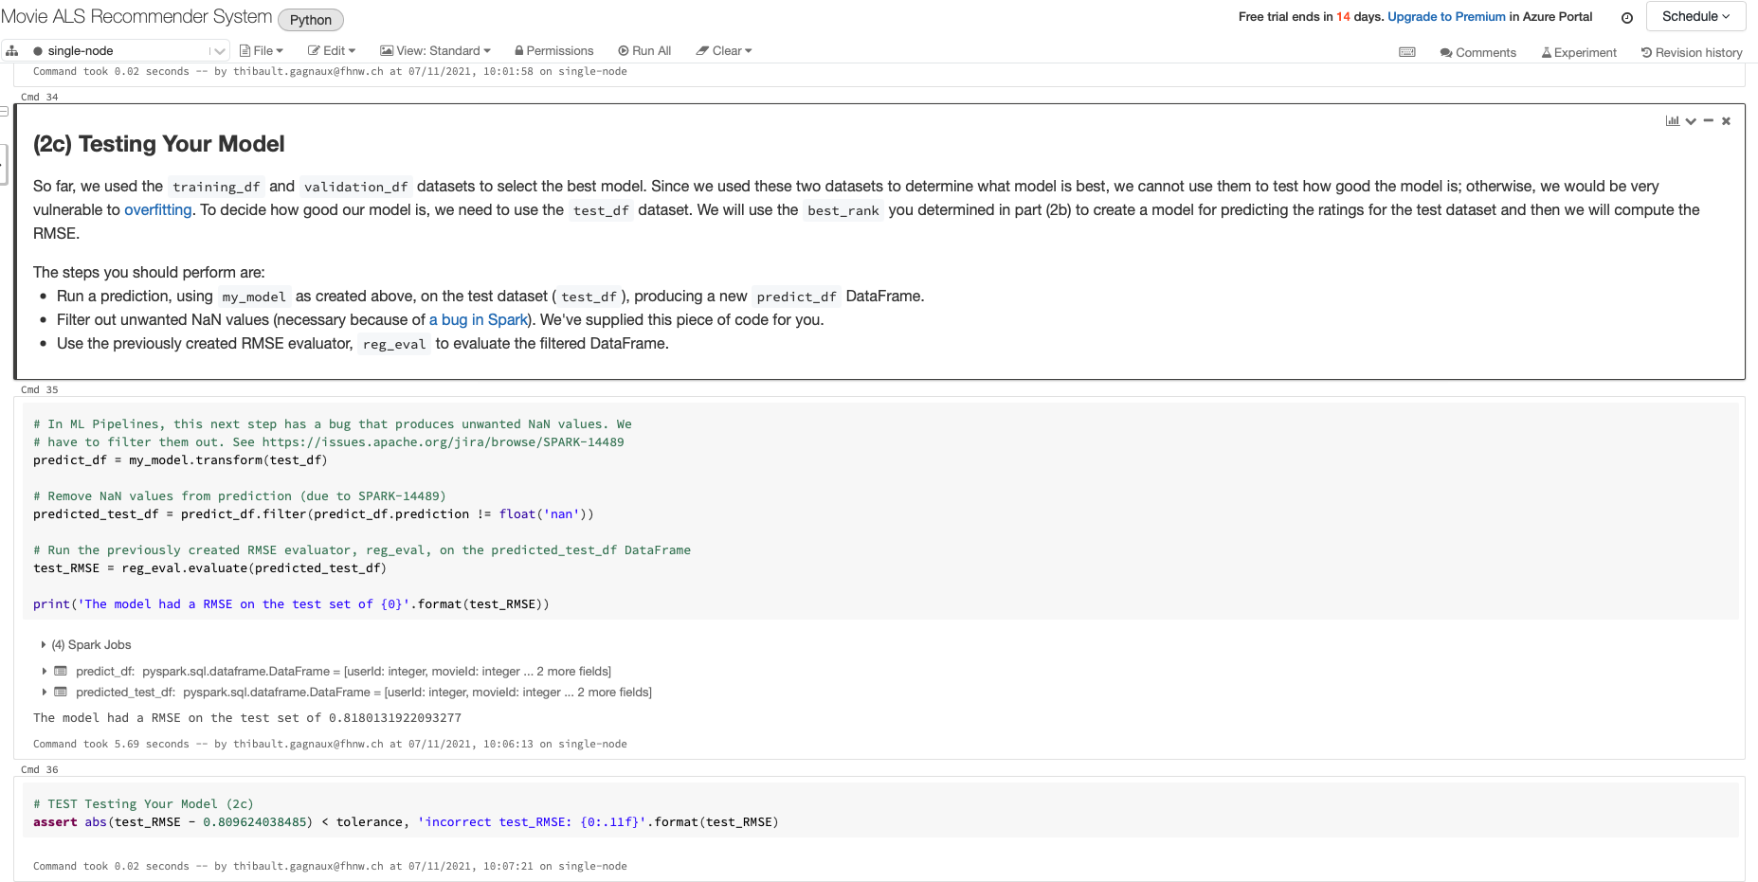
Prototype using Databricks
https://towardsdatascience.com/prototyping-a-recommender-system-step-by-step-part-2-alternating-least-square-als-matrix-4a76c58714a1

Slide 7

Problem Realtime
Shopping is Mission-Centric
15 Million
Products
Databricks cannot help, we need some Knowledge Engineering
43 Million
Customers
Notes:
Recommendation engine which predicts a person's rating for a specific product
Improve the experience of the customer, providing a list of articles the user might be interested in purchasing in a small area of the webpage
Recommendation engines are very common among customers within online retail
The idea is to build a recommendation engine using machine learning at scale
The size of the dataset does make the complexity of the algorithm a key aspect of the challenge

Slide 8
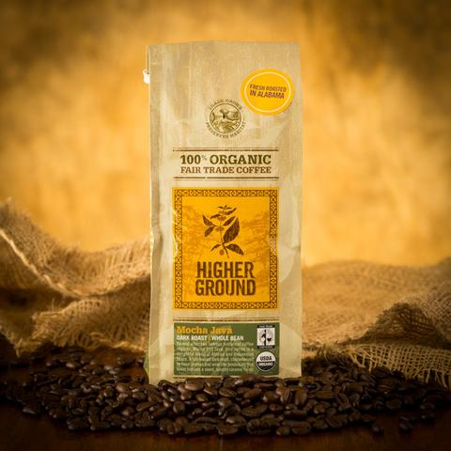
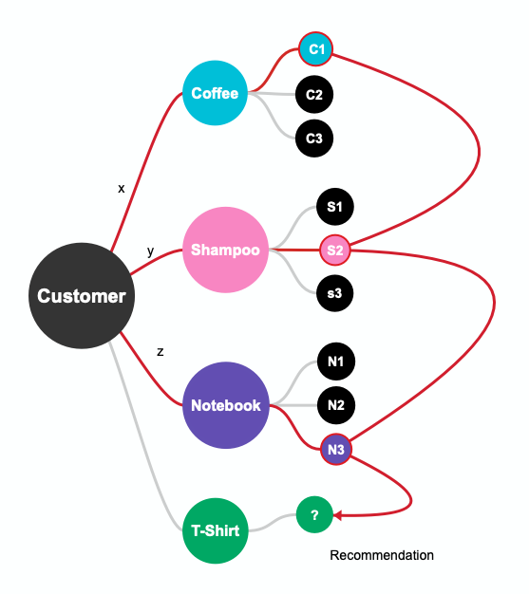
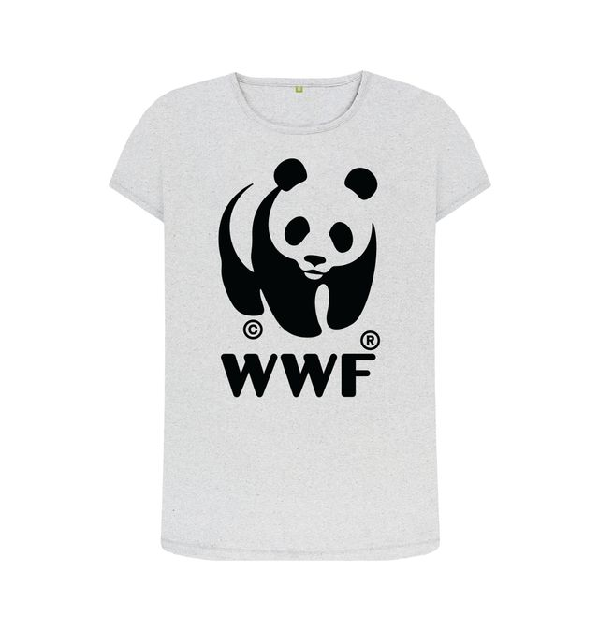
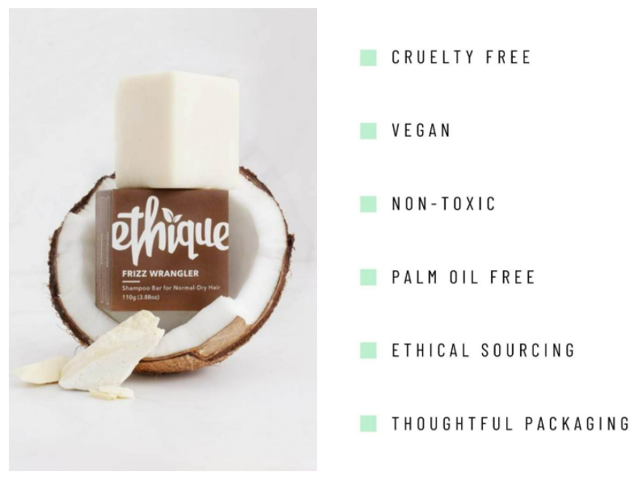
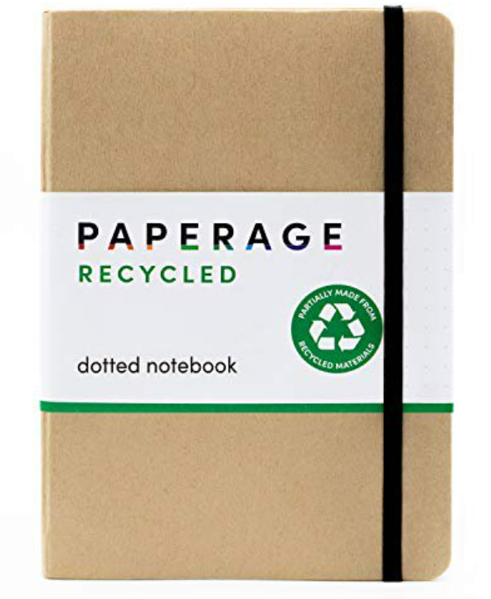
Cluster the products before clustering the customers
Recommendation
Choices are based on a common pattern
x = y = z

Slide 9

Further Ideas
Define pattern on rules:
Cluster people according to price
Cluster according to demographics
…
Relationship Graph

Slide 10
Cluster customer according to Pattern: A much smaller matrix
Sustainable
Products
Small enough Matrix for Real-Time Recommendation
Sustainable Customers

Slide 11

Q&A

